Slide 1
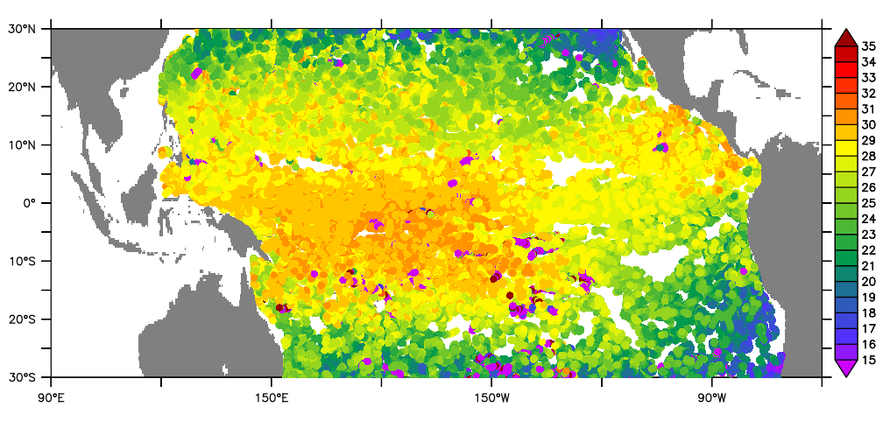
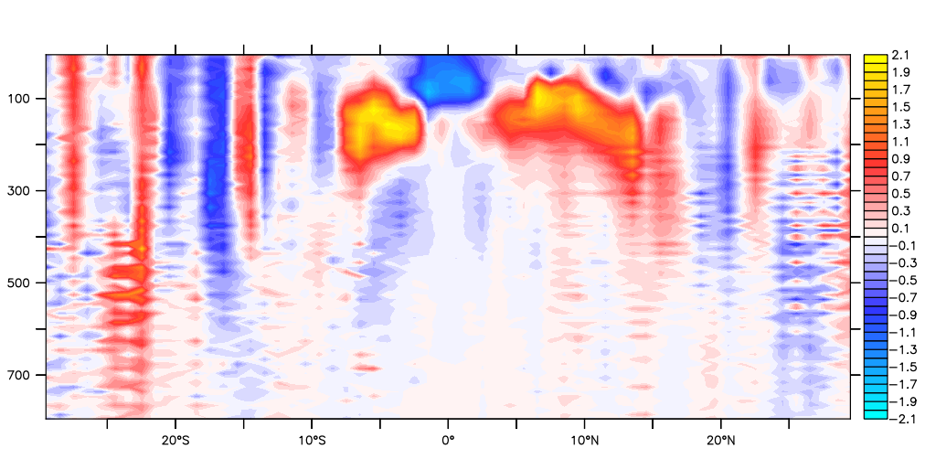
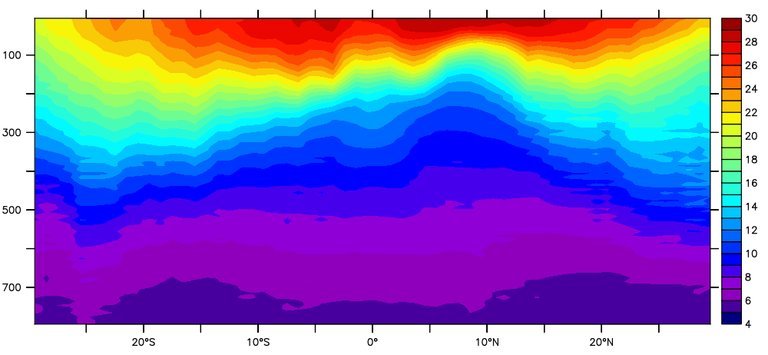
Integrating Data and Information Across Observing System
Kevin O’Brien
U of Washington
NOAA/PMEL
JCOMM OCG

Slide 2
Integration and Interoperability, what is it?
Three broad categories of integration by example:
Collecting single observing system observations
All data from Oceansites in a common data and metadata format
Multiple observing systems, across an EOV/ECV (SST)
Surface Temp from moored and drifting buoys, ARGO, and hydrographic stations
Cross-system, multi-variable reference collections
World Ocean Database (WOD), International Comprehensive Ocean-Atmosphere Data Set (ICOADS), Surface Ocean C0₂ Atlas (SOCAT)

Slide 3
JCOMM OCG ACTION: to develop vision for integration of data across observing systems.
A Piloting (prototyping) Activity to Address Key Challenges of the JCOMM OCG Task Team on Integrated Data Access
Chose to focus on Tropical Pacific in support of TPOS 2020
Build an integrated framework of ocean observation data from multiple platform networks or data sources:
Drifting Buoys
Argo Floats
SOT/VOS data (CCHDO)
SOCAT underway data
IOOS Glider data
OceanSITES stations
Tropical Moorings, Stratus, WHOTS, CCE1,CCE2
Real Time data from OSMC GTS
Selected ERDDAP as data framework for integrating the observations

Slide 4
Digression: DAP in the modeling community
Data Access Protocol (DAP) (originally Distributed Oceanographic Data System (DODS)), revolutionized how data was accessed
User could use familiar applications and not worry about data formats
Users could access complete model runs with a single command (time series analysis, etc)
Allows for access of heterogeneous datasets in a highly distributed environment
OPeNDAP servers (Hyrax, THREDDS data server) are now the de facto way to serve such data.
Many barriers to interoperable access of gridded/model data have been removed thanks to DAP
See Unified Access Framework project which offers access to 6K+ datasets in a uniform way

Slide 5
Digression: DAP for the ocean observation community
ERDDAP is DAP, but for in situ data!
ERDDAP can also revolutionize how people serve, access and use observational data
ERDDAP is NOT a portal - it’s a framework upon which portals can easily be built
From Provider standpoint:
Can ingest many existing formats and make available through interoperable web services – flexible!
From user standpoint
Can access and use observations and “collections” of observations with familiar clients without worrying about data format
Provides machine to machine access with RESTful web services

Slide 6
Digression: DAP for the ocean observation community
ERDDAP is DAP, but for in situ data!
Reducing the time required to deal with data management allows more time for scientific productivity
Does it solve all the problems?
No. But can significantly improve integration of many types of data already.
Leveraging existing standards, conventions and frameworks, such as ERDDAP, allows us to solve many of these issues at significantly reduced costs.
Access to RT ocean observations available through OSMC/ERDDAP
Used by John Wilken @ Rutgers to ingest profile data into forecast model

Slide 7
JCOMM OCG ACTION: to develop vision for integration of data across observing systems.
Back to TPOS prototype

Slide 8
JCOMM OCG ACTION: to develop vision for integration of data across observing systems.

Slide 9
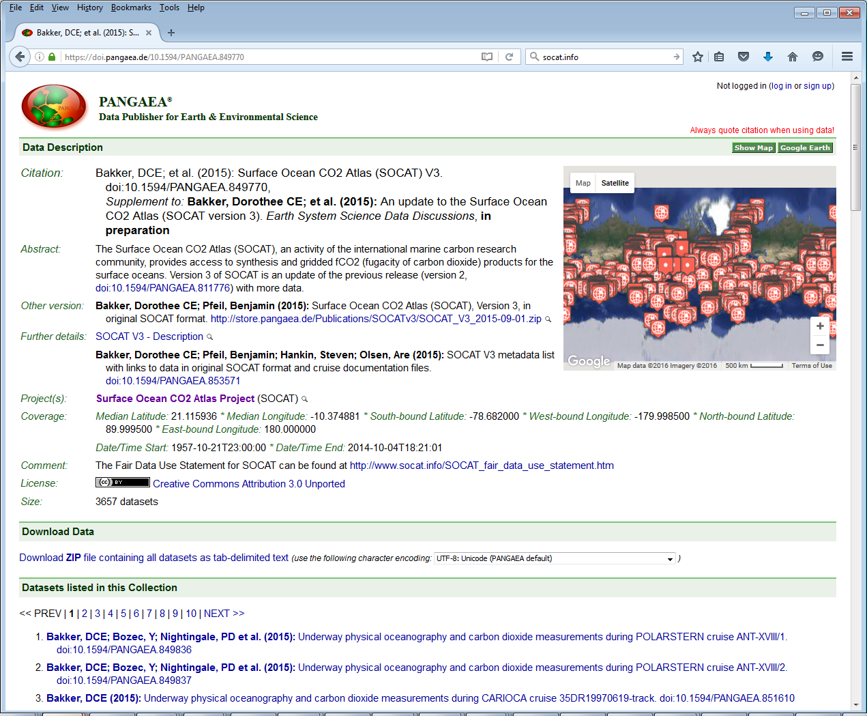
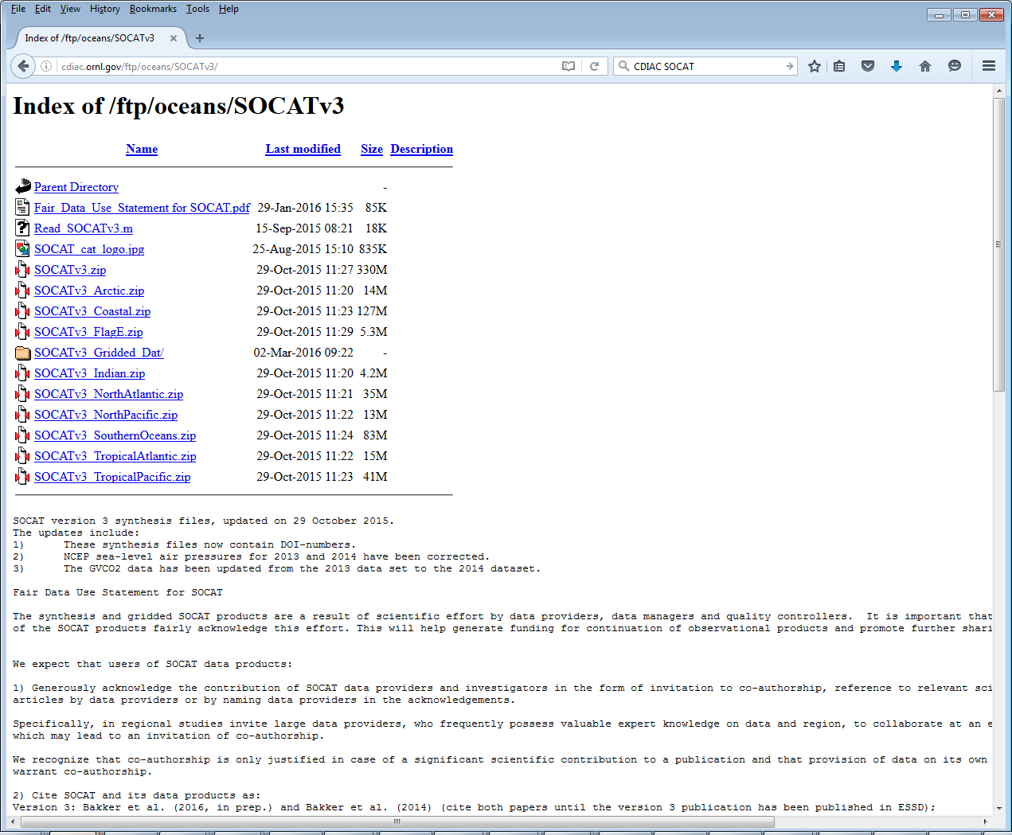
SOCAT v3 data access

Slide 10
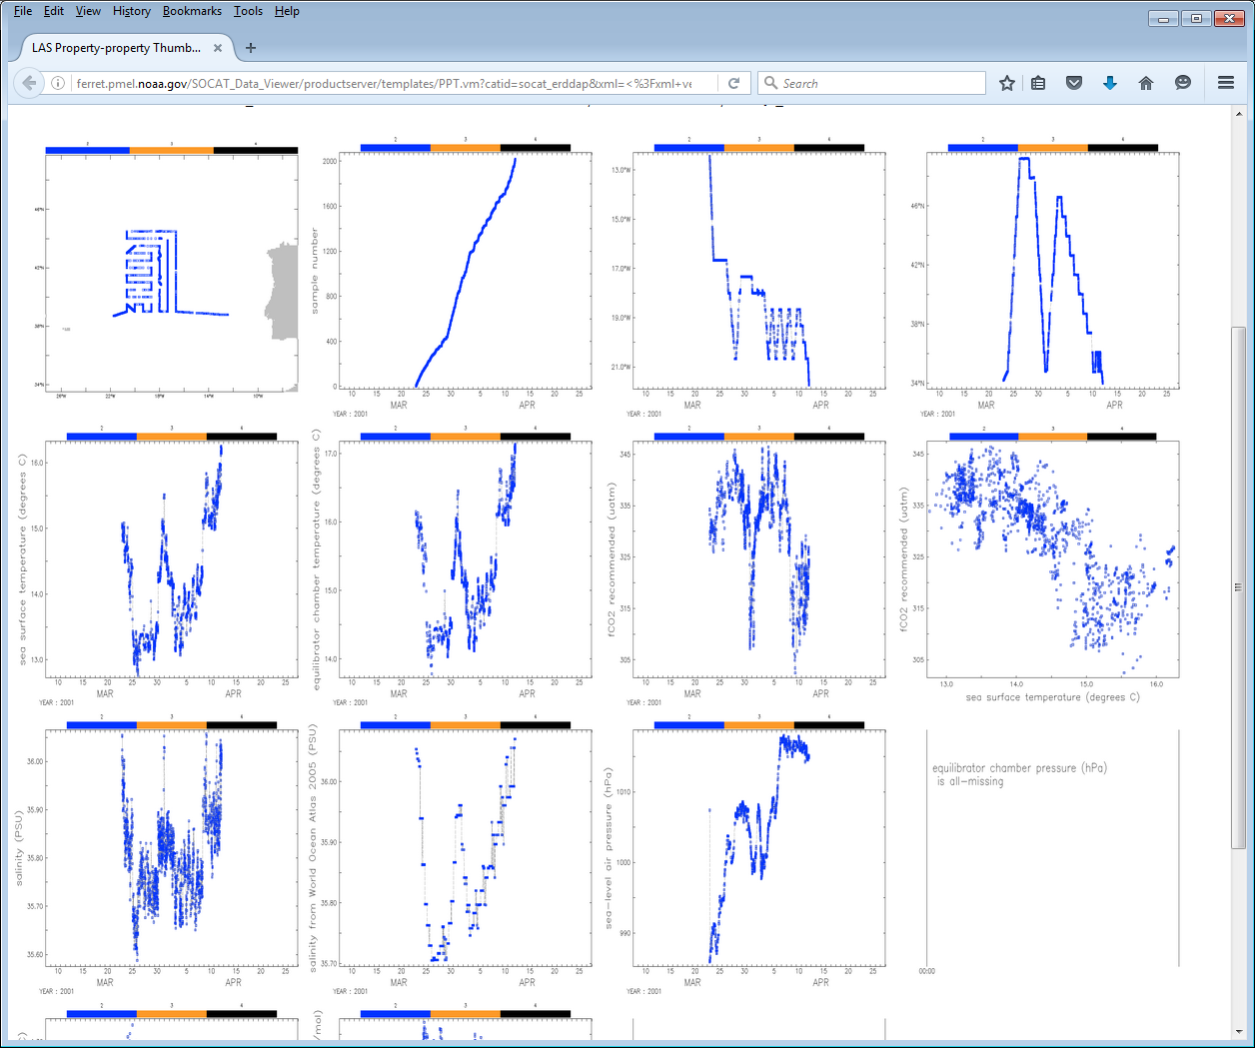
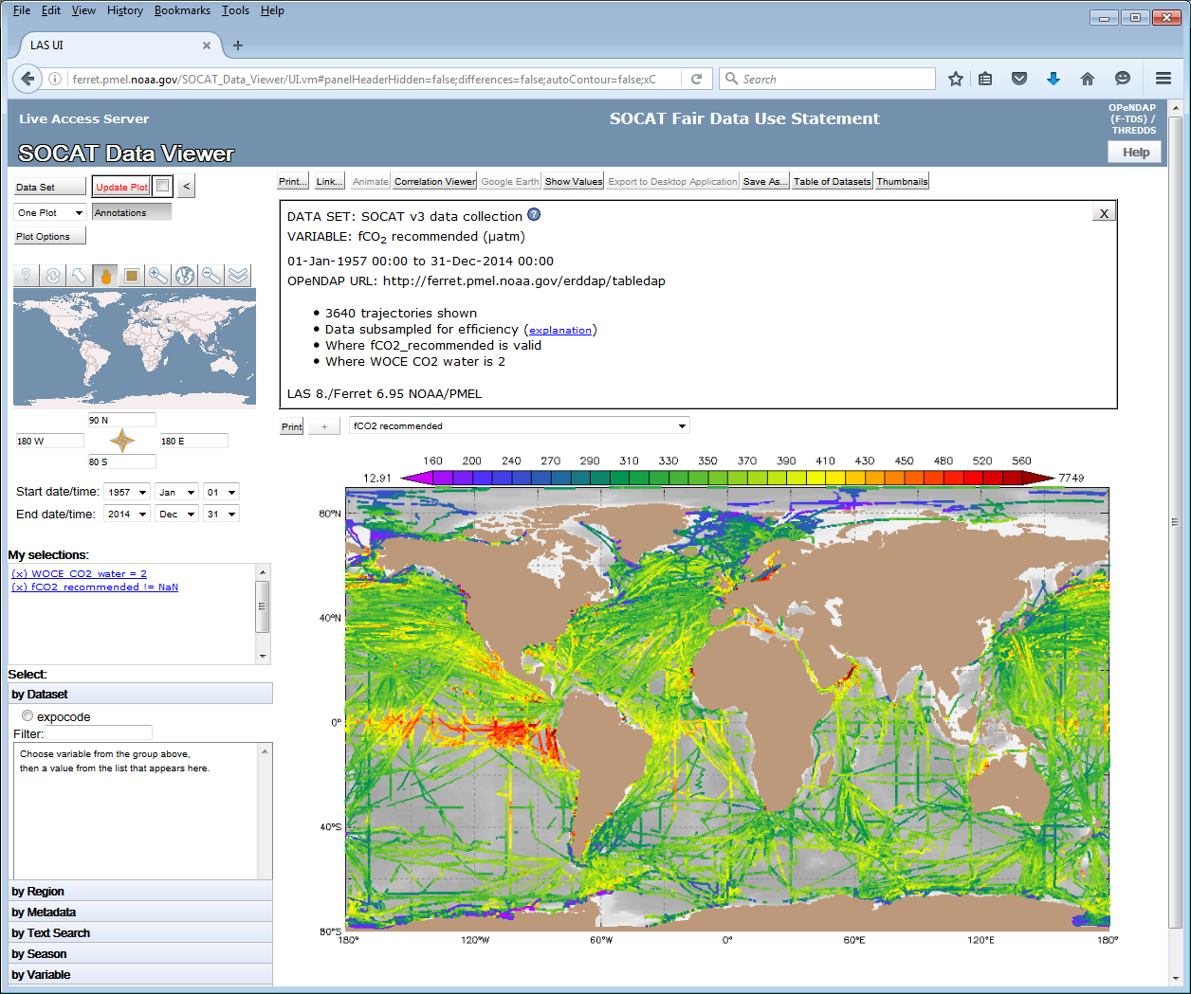
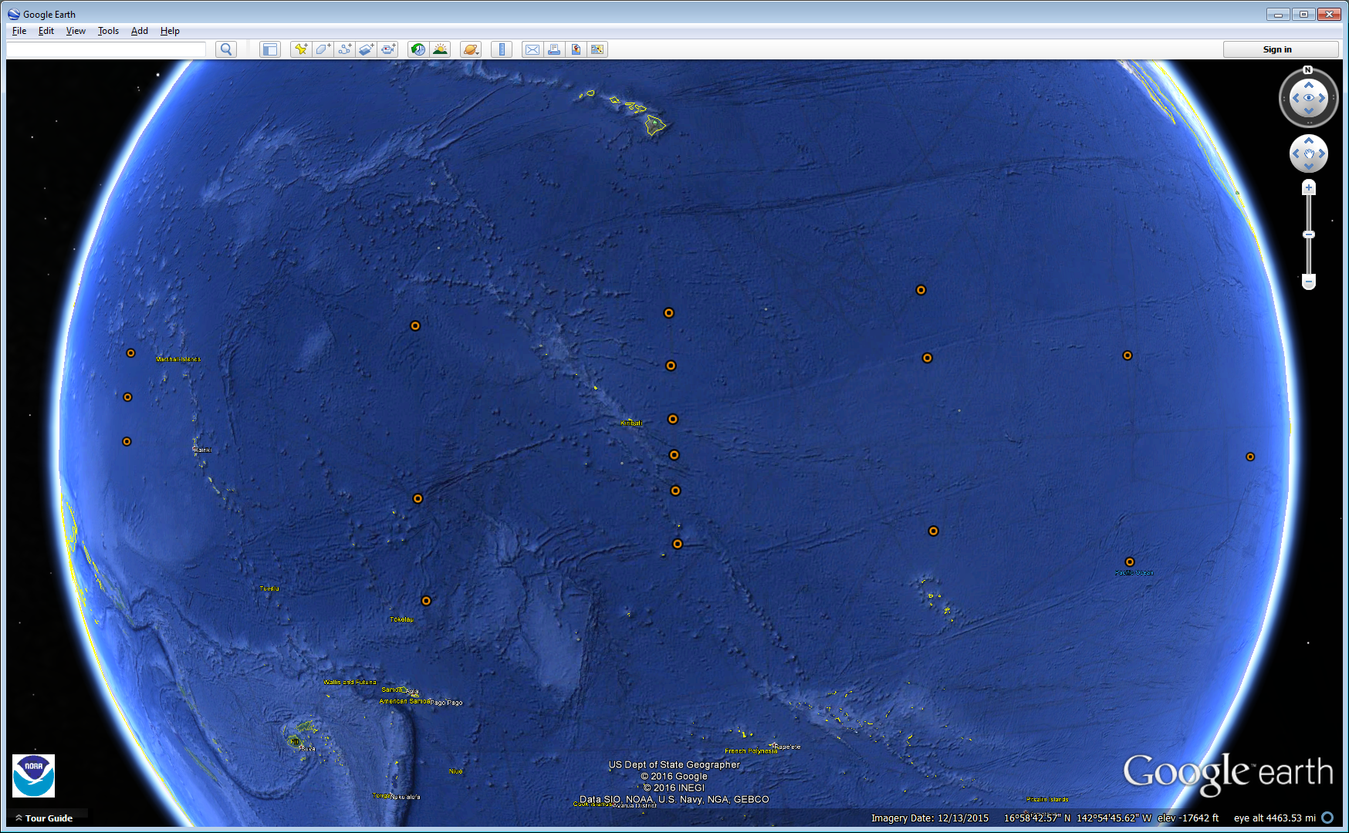
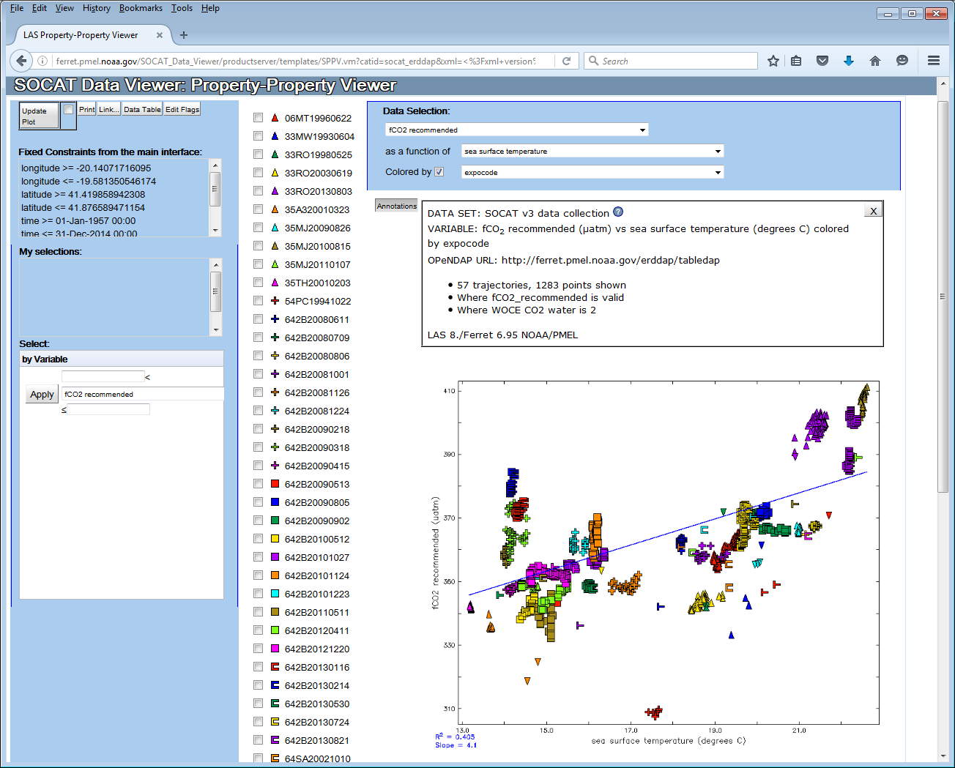
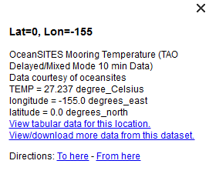
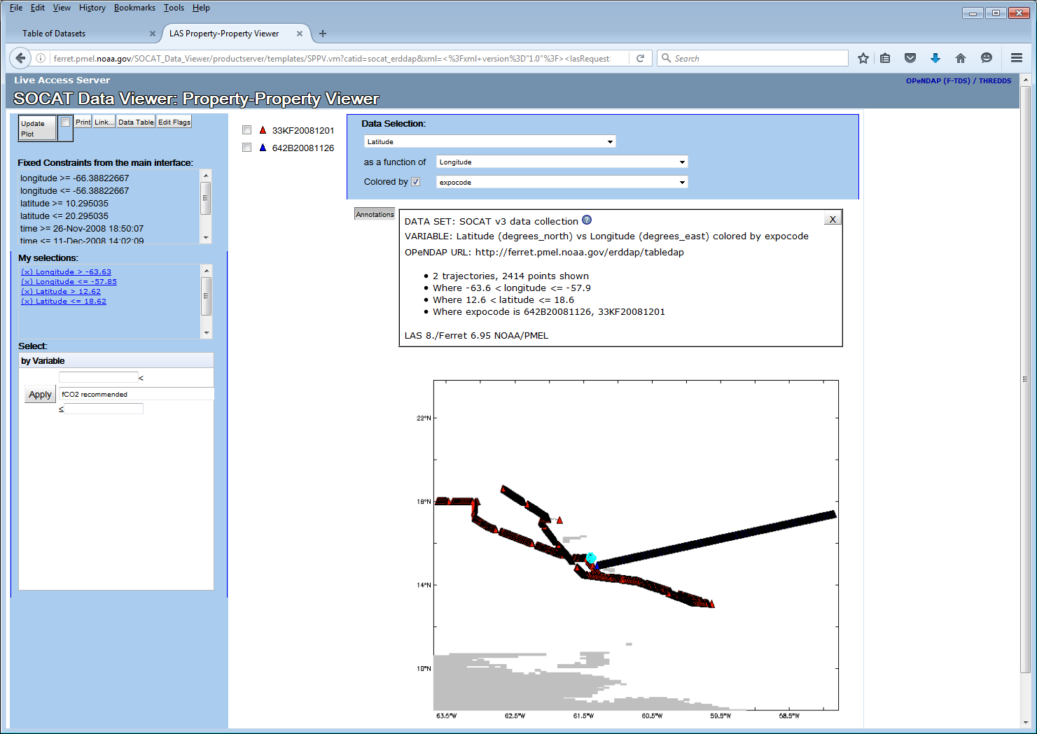
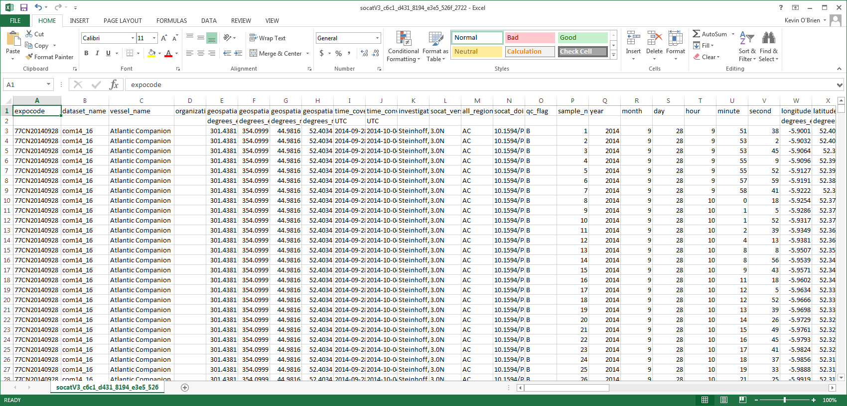
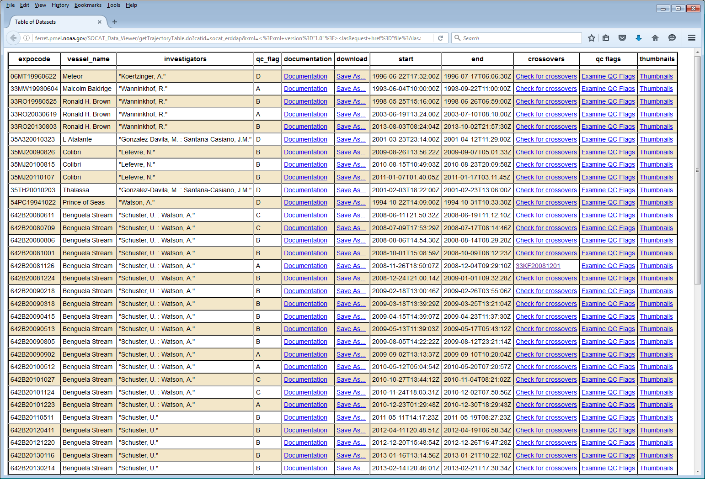

Slide 11
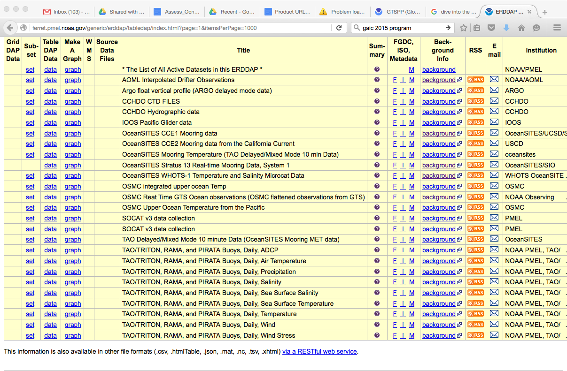
JCOMM OCG ACTION: to develop vision for integration of data across observing systems.

Slide 12
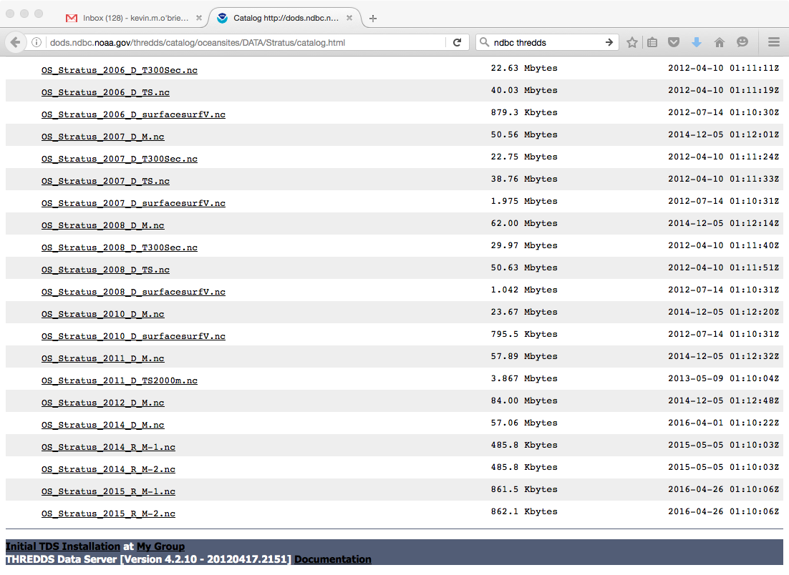
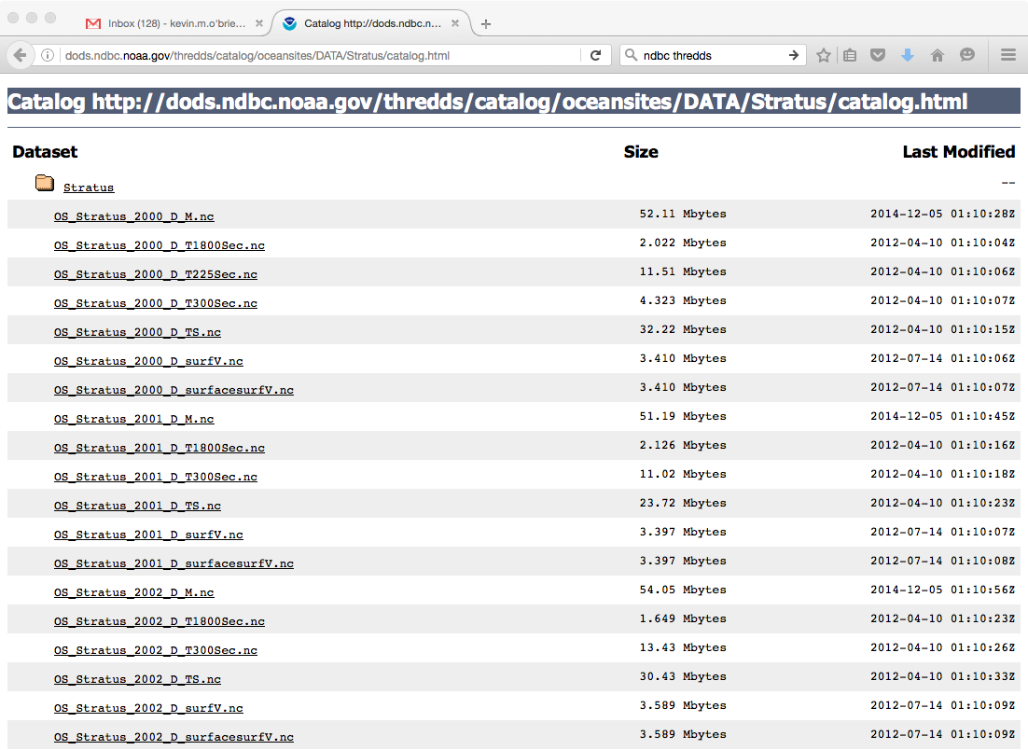
OceanSITES example - Stratus

Slide 14
https://www.youtube.com/watch?v=jkhck_GXSiM

Slide 15
JCOMM OCG ACTION: to develop vision for integration of data across observing systems.
Further possibilities
Integrating across EOV – Temperature example

Slide 16
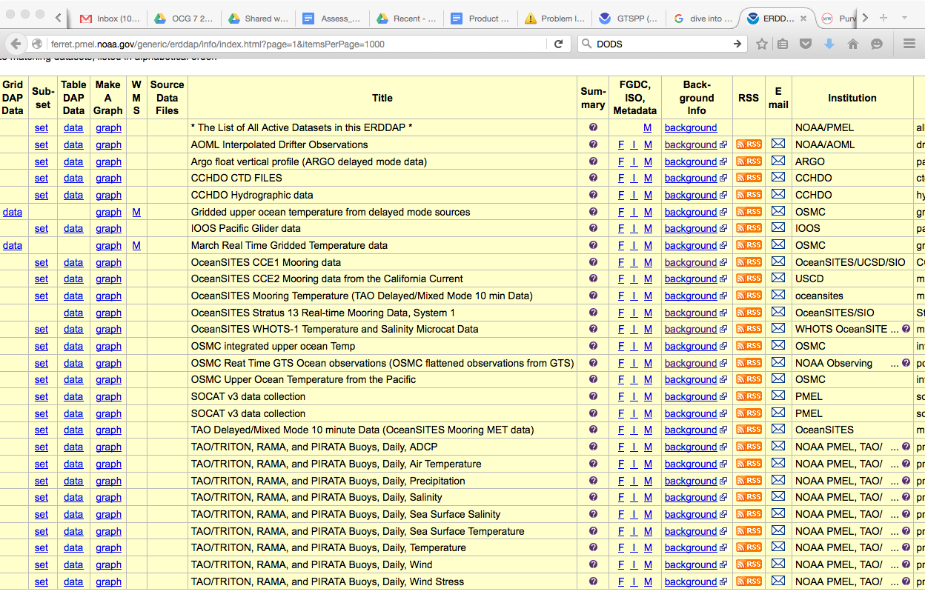
JCOMM OCG ACTION: to develop vision for integration of data across observing systems.

Slide 17
use http://ferret.pmel.noaa.gov/generic/erddap/tabledap/integrated_temp.nc
shade/z=0 temp

Slide 18
2014 Tropical Pacific temperature, averaged over time and longitude
2015 Tropical Pacific temperature, averaged over time and longitude
Notes:
1x1 degree boxes
vertical regridding - 10m (depth should go to about 700m)
simple average in each volume

Slide 19
Temperature difference between 2014 and 2015

Slide 20
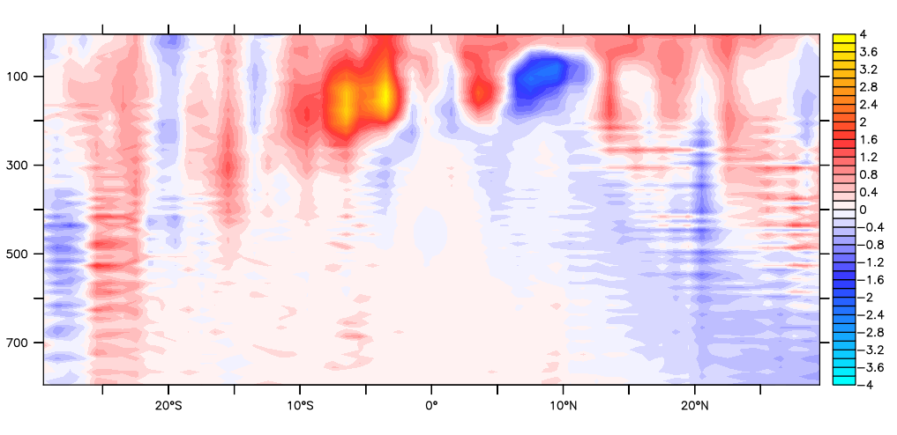
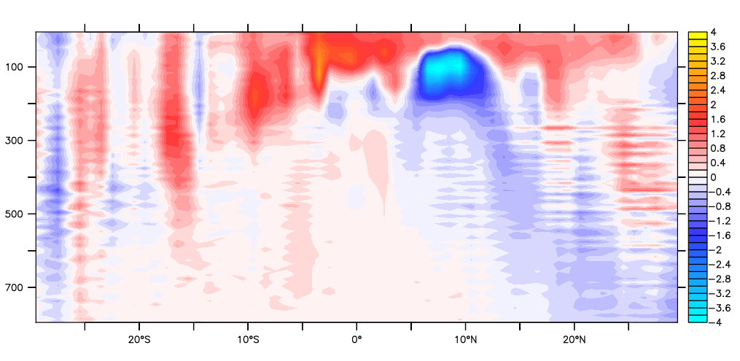
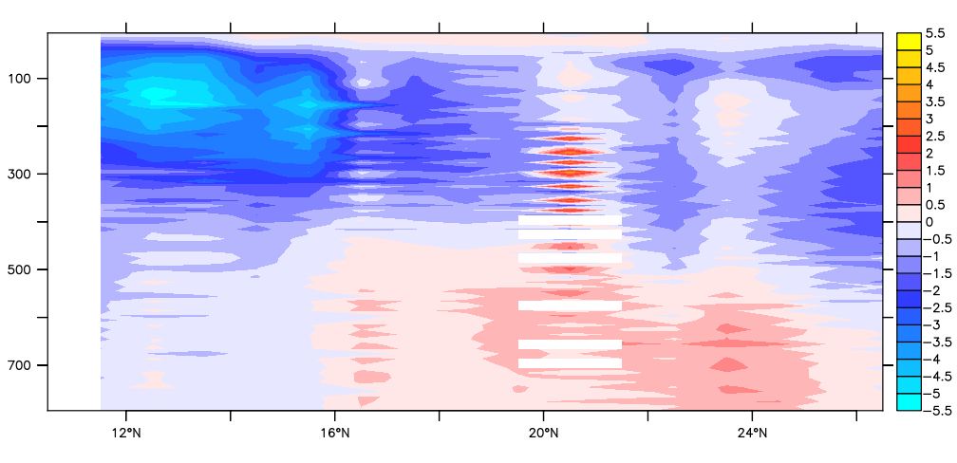
2014 TEMP Anomalies from WOA
JCOMM OCG 7 ACTION: Refine the vision for Data Integration EOV activity in a few pages (max) and distribute to OCG members
2015 TEMP Anomalies from WOA
Oct 2015 TEMP Anomalies from PacIOOS ROMS CNMI

Slide 21
Benefits
Improve user access to data
“Best time series”
Remove DM burden from user
Easier to integrate data into models
Easier to create synthesis products based upon data
Support machine to machine services
Critical to interoperability
Can help meet national requirements for data documentation, discovery, access and archival
May help ease some of TC burden

